Slide 1
Objects moving in a Straight Line (One-dimensional motion) Chapter 2: Fundamentals of Physics by Halliday, Resnick
Waheed Ahmad
Lecturer (physics)
FAST-National University of COMPUTER AND EMERGING SCIENCES

Slide 2
Outline
Concept of Motion in Physics
Scalars and Vectors
Position, Displacement and Distance
Speed and Velocity
Velocity-Time Graphs
Position-Time Graphs
Acceleration
Constant Acceleration
Gravitation Acceleration
Acceleration-Time Graphs

Slide 3
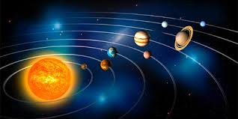
Concept of Motion in Physics
Everything around us is moving, but motion is not absolute.
Motion is a Relative concept.
Kinematics: Describes the motion.
Dynamics: Describes the causes of motion.
Fig. 2.1

Slide 4
Concept of Motion in Physics
For this chapter, We restrict motion in three ways
We consider motion along a straight line only.
We discuss motion itself , not the forces that cause it.
We consider the moving object to be a particle.
A particle is either
A point-like object such as an electron
Or an object that moves such that each part travels in the same direction at the same rate (no rotation or stretching)

Slide 5
Concept of Motion in Physics
What Parameters do we measure for an object to be in motion?
Position
Velocity
Acceleration

Slide 6
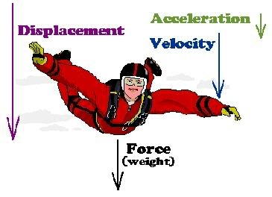
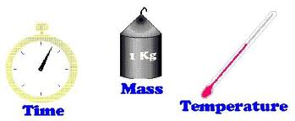
Scalars and Vectors
Scalars: can be described with a single number (including any units) giving its magnitude.
Fig. 2.2
Vectors: must be described with both magnitude and direction.
Fig. 2.3

Slide 7
Scalars and Vectors
Check your Understanding
Which of the following statement involves a vector ?
I jumped off a cliff and hit the water traveling at 17 miles per hour.
I jumped off a cliff and hit the water traveling straight down at 17 miles per hour.
My bank account shows a negative balance of –25 dollars.

Slide 8

Position, Displacement and Distance
Where is the object?
Position is the location of the object (whether it's a person, a ball, or a particle) at a given moment in time.
Position is measured relative to a reference point called origin, or zero point, of an axis.
Position has a sign:
Positive direction is in the direction of increasing numbers.
Negative direction is opposite the positive.
Fig. 2.2
Position of particle at B is 3 m.
Position of particle at A is -4 m.

Slide 9

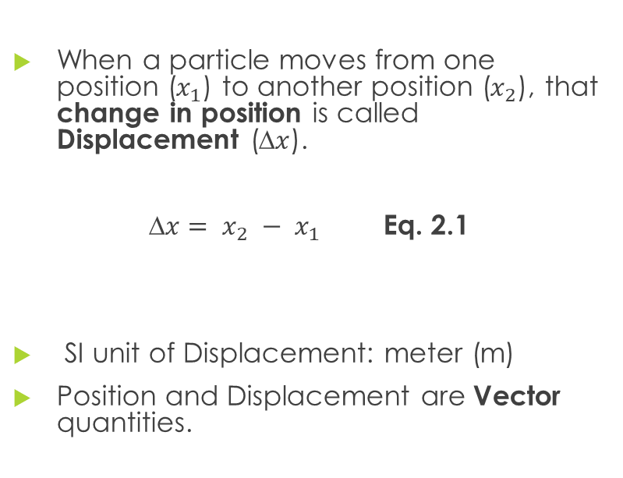
Position, Displacement and Distance
When a particle moves from one position ($x_{1}$) to another position ($x_{2}$), that change in position is called Displacement (∆$x$).
∆$x= x_{2} − x_{1}$ Eq. 2.1
SI unit of Displacement: meter (m)
Position and Displacement are Vector quantities.
Fig. 2.3
If a particle moves from O to B, its displacement is 3 m.
If a particle moves from O to A, its displacement is −4 m.
If a particle moves from A to B, its displacement is 7 m.
If a particle moves from B to A, its displacement is −7 m.

Slide 10
Position, Displacement and Distance
Distance is the total number of meters the object has traveled in a certain period of time.
Scalar Quantity. (meter)
Distance and displacement are the same in the case where the object travels in a straight line and always moving in the same direction.
always positive or zero.
Fig. 2.4
a particle moves from A to B and then to O
Displacement is
4 m
Distance is
10 m

Slide 11
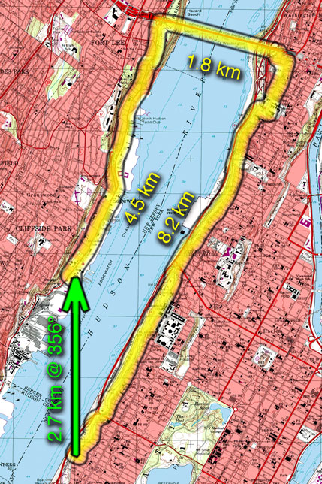
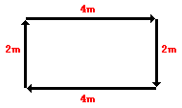
Position, Displacement and Distance
Fig. 2.6
A physics teacher walks 4 meters East, 2 meters South, 4 meters West, and finally 2 meters North. Displacement and Distance values?
Fig. 2.5

Slide 12
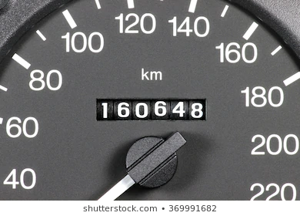
Position, Displacement and Distance
Food for Thought
What does the odometer reading in car measure? Is it distance or displacement ?
Suppose you want to predict how long it takes to get to Lahore from Faisalabad. Do you care about the distance you’ll travel or your displacement ? Explain.
Fig. 2.7

Slide 13
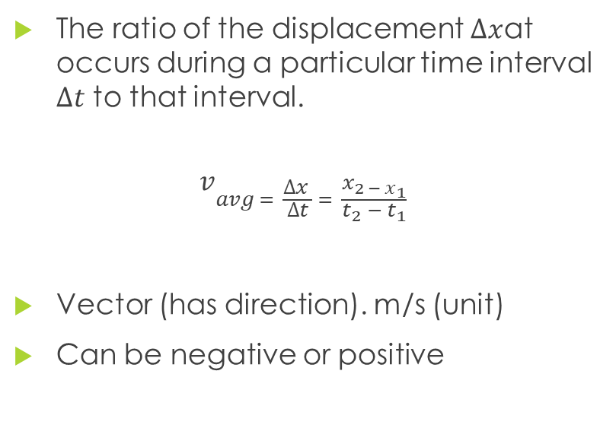
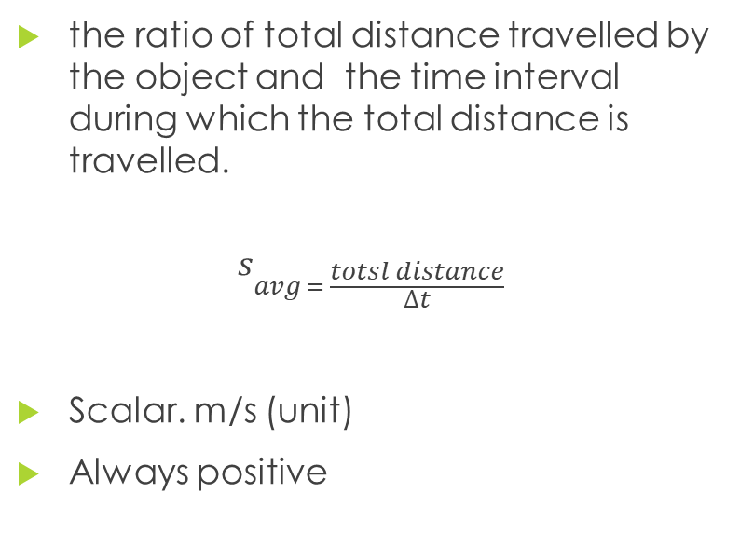
Speed and Velocity
Average speed
Average Velocity
the ratio of total distance travelled by the object and the time interval during which the total distance is travelled.
$$s_{avg = \frac{totsl distance}{∆t}}$$
Scalar. m/s (unit)
Always positive
The ratio of the displacement $∆x$at occurs during a particular time interval $∆t$ to that interval.
$$v_{avg = \frac{∆x }{∆t} = \frac{x_{2 − x_{1}}}{t_{2} − t_{1}}}$$
Vector (has direction). m/s (unit)
Can be negative or positive

Slide 14
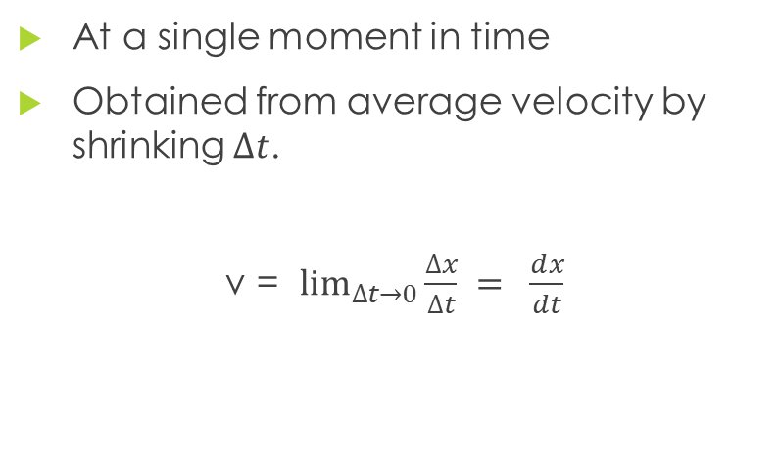
Speed and Velocity
Instantaneous Speed
Instantaneous Velocity
typically called simply speed, is just the magnitude of the instantaneous velocity vector.
At a single moment in time
Obtained from average velocity by shrinking $∆t$.
v = $\lim_{∆t→0}{\frac{∆x}{∆t}} = \frac{ⅆx}{dt}$

Slide 15
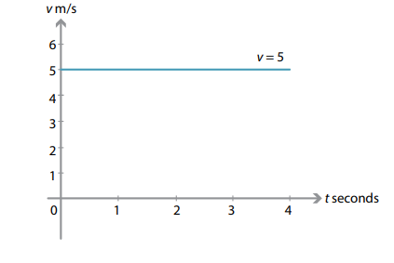
Velocity-Time graphs
The diagram shows constant velocity.
Particle moving at 5m/s for 4s.

Slide 16
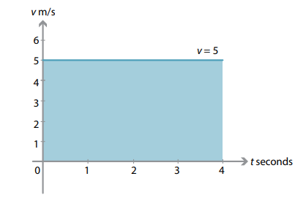
Velocity-Time graphs
s the product of the velocity and the time taken is the shaded area (rectangle).
5 × 4 = 20m
this area represents the displacement.

Slide 17
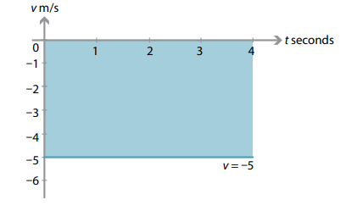
Velocity-Time graphs
If the particle has a constant velocity of −5 m/s for 4 seconds.
a displacement of −20 m

Slide 18

Position-time graphs
a particle moves with constant velocity from point A to point B, as shown in the diagram.
At time t = 1, the position of the particle is 3 m to the right of O, that is, x(1) = 3. At time t = 4, its position is 9 m to the right of O, that is, x(4) = 9.

Slide 19

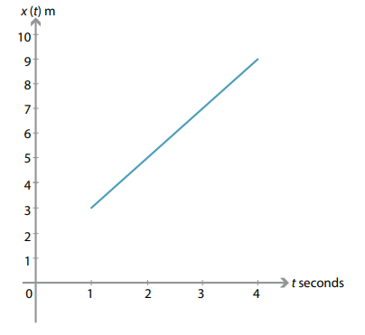
Position-time graphs
this is the displacement divided by the time taken, the gradient of the line is equal to the velocity.

Slide 20

Position-time graphs
Assume that a particle moves with constant velocity from A to B, as in the diagram.
At time t = 1, the position of the particle is 3 m to the right of O, that is, x(1) = 3. At time t = 4, its position is 3 m to the left of O, that is, x(4) = −3.

Slide 21
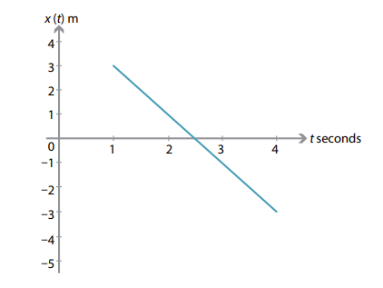

Position-time graphs
The displacement is −6 metres over 3 seconds. Therefore the constant velocity is −2 m/s.

Slide 22
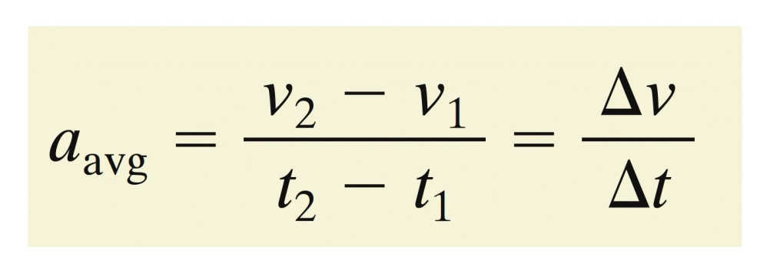
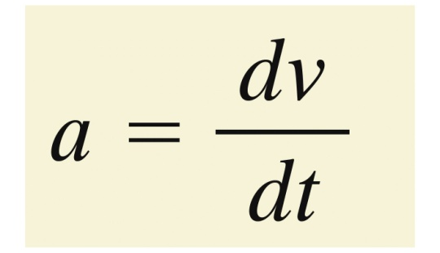
Acceleration
A change in a particle's velocity is acceleration
Average acceleration over a time interval ∆t is
Instantaneous acceleration (or just acceleration), a, for a single moment in time is:

Slide 23
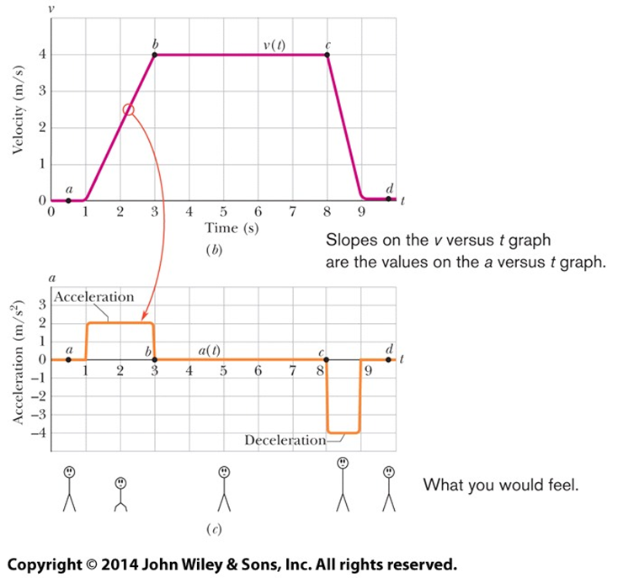
Acceleration
The graph shows the velocity and acceleration of an elevator cab over time.

Slide 24
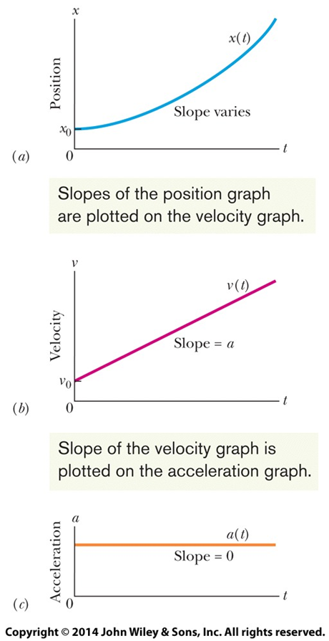
Constant acceleration
In many cases acceleration is constant, or nearly so.
For these cases, 5 special equations can be used.
Note that constant acceleration means a velocity with a constant slope, and a position with varying slope (unless a = 0).

Slide 25
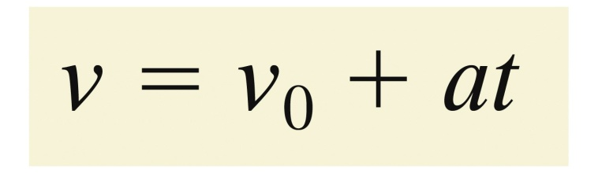
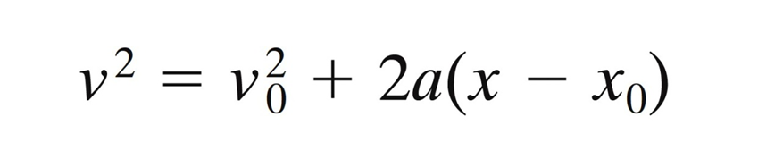
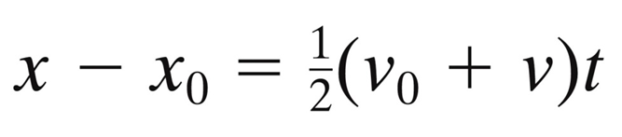

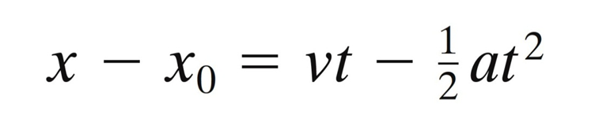
Constant acceleration

Slide 26
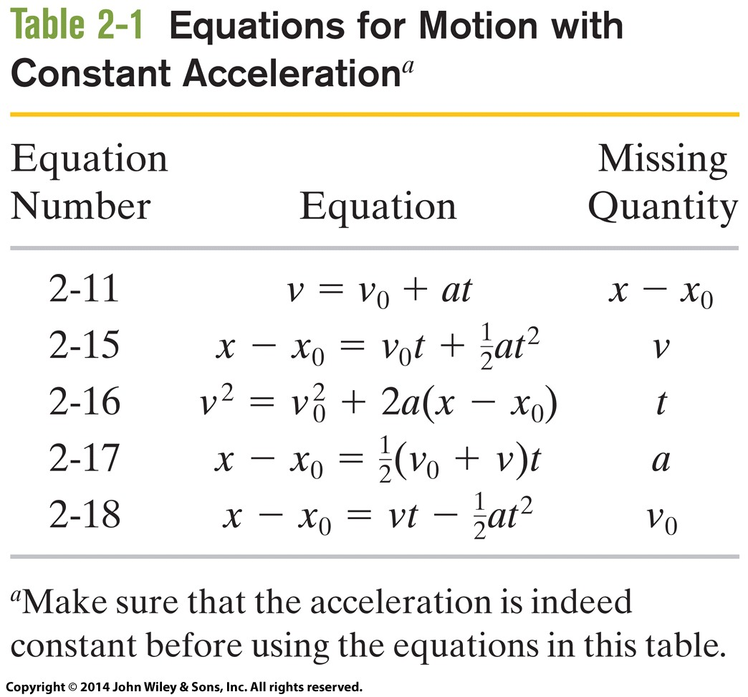
Constant acceleration

Slide 27
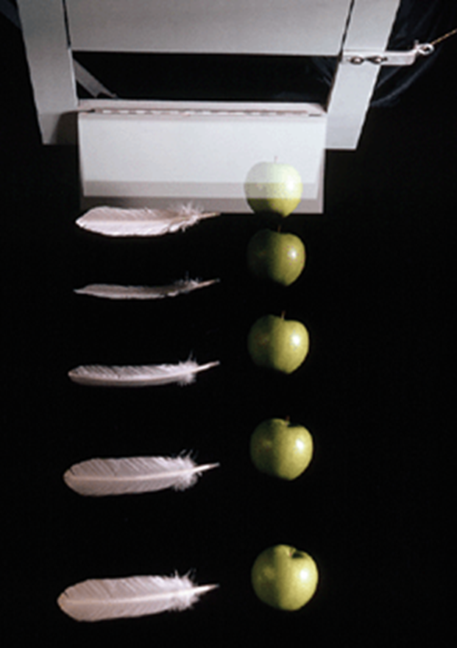
Gravitational- Acceleration

Slide 28
Gravitational- Acceleration
Also called free-fall acceleration.
is the rate at which an object accelerates downward in the absence of air resistance
Varies with latitude and elevation
Written as g, standard value of 9.8 m/s²
Independent of the properties of the object (mass, density, shape, see Figure 2-12)
The equations of motion in Table 2-1 apply to objects in free-fall near Earth's surface
In vertical flight (along the y axis)
Where air resistance can be neglected

Slide 29
Sample problems
Let’s do some sample problems
You drive a pickup truck along a straight road for 8.4 km at 70 km/h, at which point the truck runs out of gasoline and stops. Over the next 30 min, you walk another 2.0 km farther along the road to a gasoline station.
(a) What is your overall displacement from the beginning of your drive to your arrival at the station?
(b) What is the time interval from the beginning of your drive to your arrival at the station? What is your average velocity from the beginning of your drive to your arrival at the station? Find it both numerically and graphically. Suppose that to pump the gasoline, pay for it, and walk back to the truck takes you another 45 min. What is your average speed from the beginning of your drive to your return to the truck with the gasoline?

Slide 30
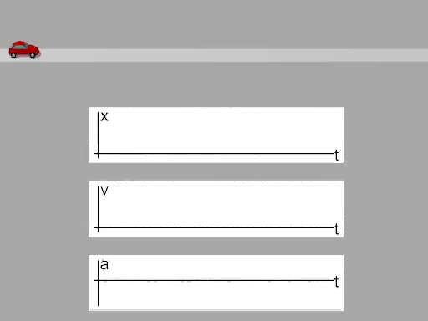
Some animations
https://www.vascak.cz/data/android/physicsatschool/templateimg.php?s=mech_pohyb&l=en

